Slide 1

INTERNSHIP PROJECT
SUBMITTED BY:- SHIVAM SHARMA
:- SHIVAM NAUTIYAL
COURSE/BRANCH :- B.TECH
SEMESTER/SECTION:- 5th SEM , 5C
UNIVERSITY ROLL.NO:-2000290120150

Slide 2
TITLE OF THE PROJECT
Whatsapp
Chat analyser

Slide 3
Overview of the project
This project is the part of my summer internship held in the month of September in the department of Computer Science at KIET Group Of Institutions. The internship was based on Web Development in which I was assigned a project .
In this project I was supposed to make a whatsapp chat analyser . I made this using python and other libraries provided by python( matplotlib). The website is made using streamlit and deployed on streamlit cloud.

Slide 4


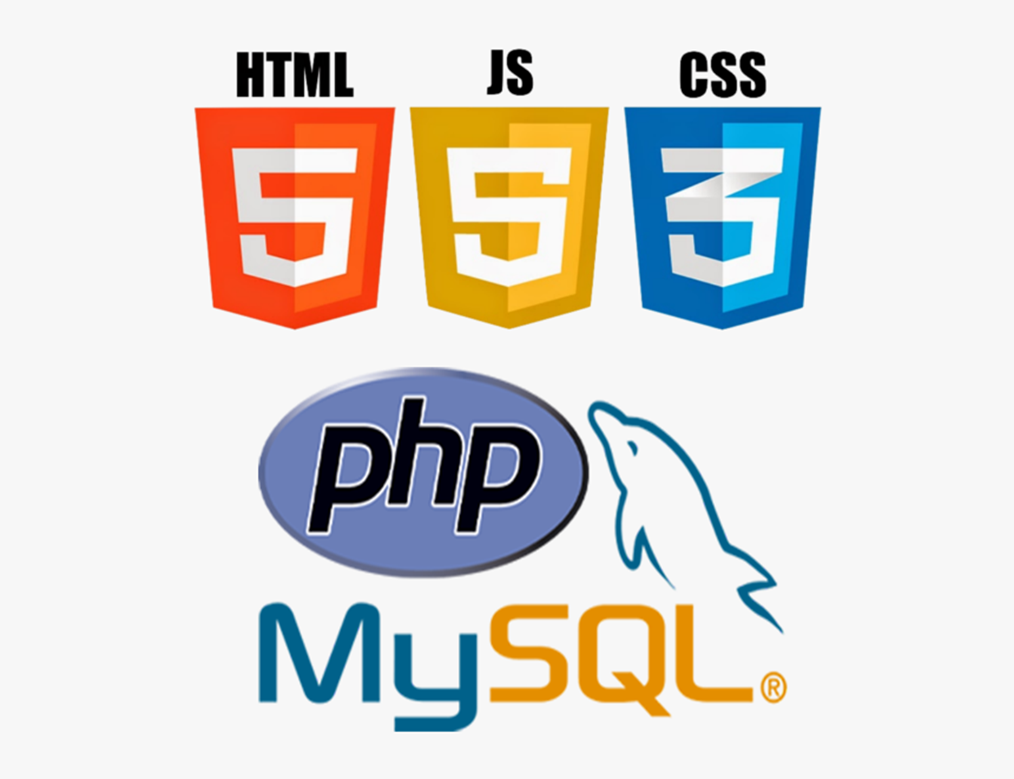


Technology used
Streamlit
Python
Matplotlib.pyplot
Machine learning

Slide 5
Link of website
https://shivamshi-shivam-wca-app-hxl40z.streamlit.app/

Slide 6
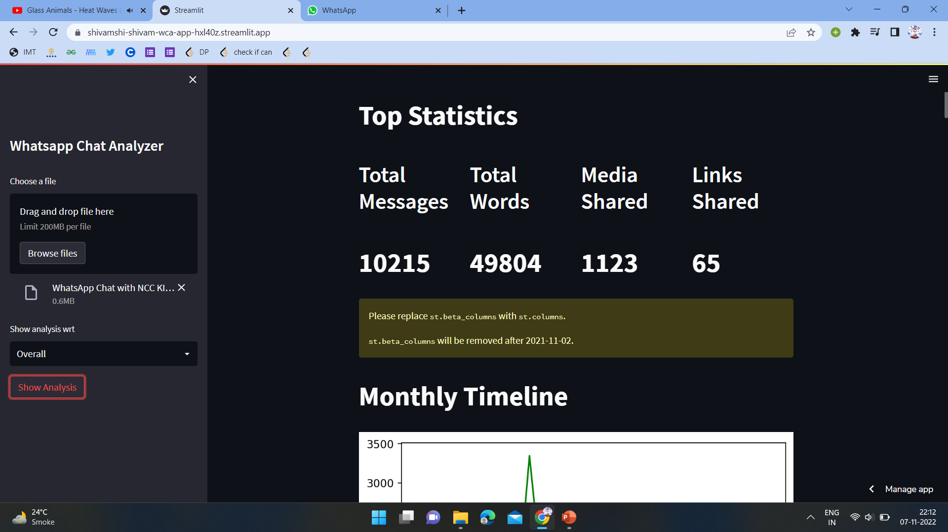
Learnings From Internship
Data Types
Loops
Control Structures
Lambda Function
Object Oriented Programming
Data Visualization
Tkinter Library and UI using Python

Slide 7
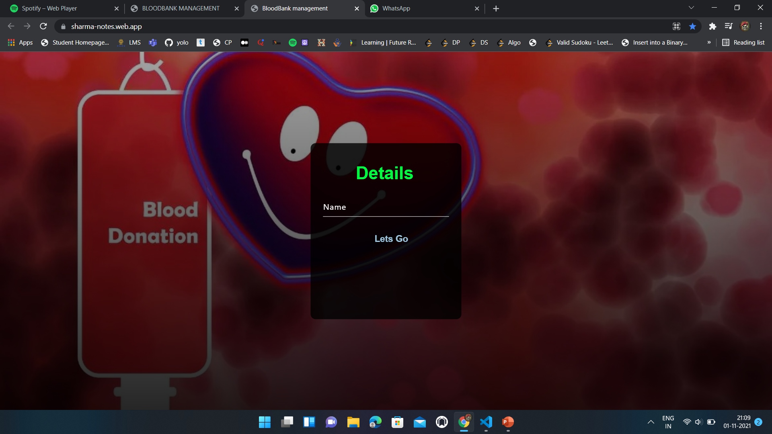
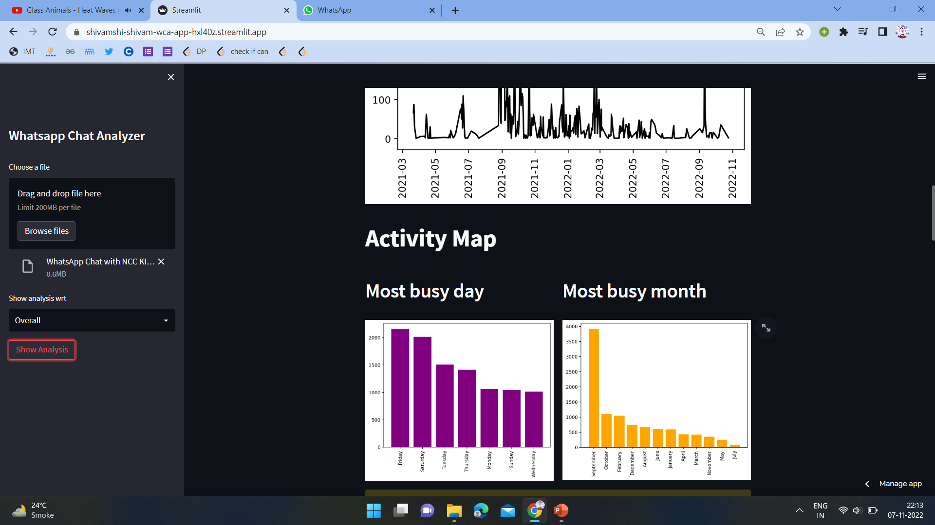
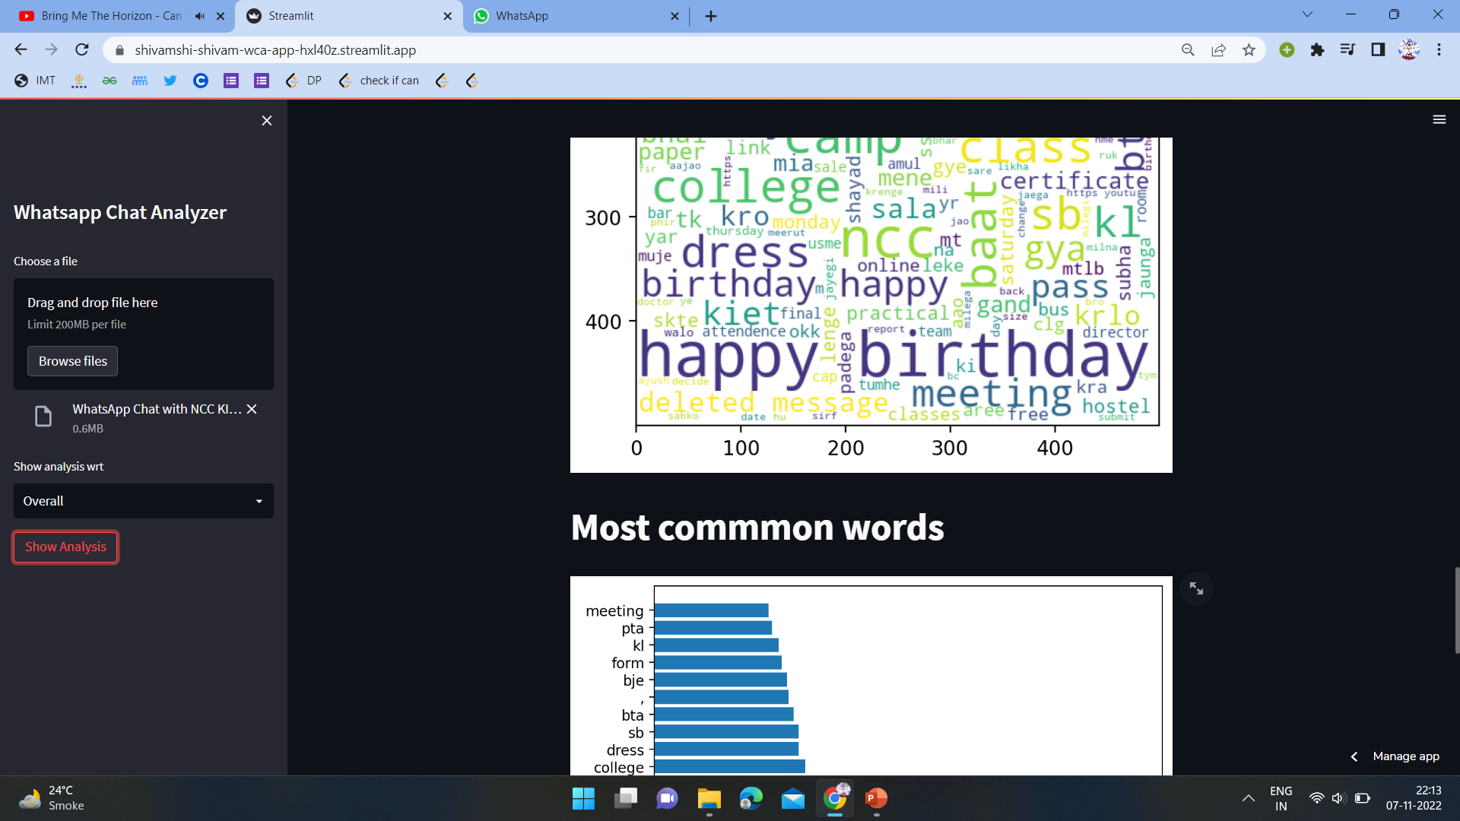

Slide 8


Slide 9
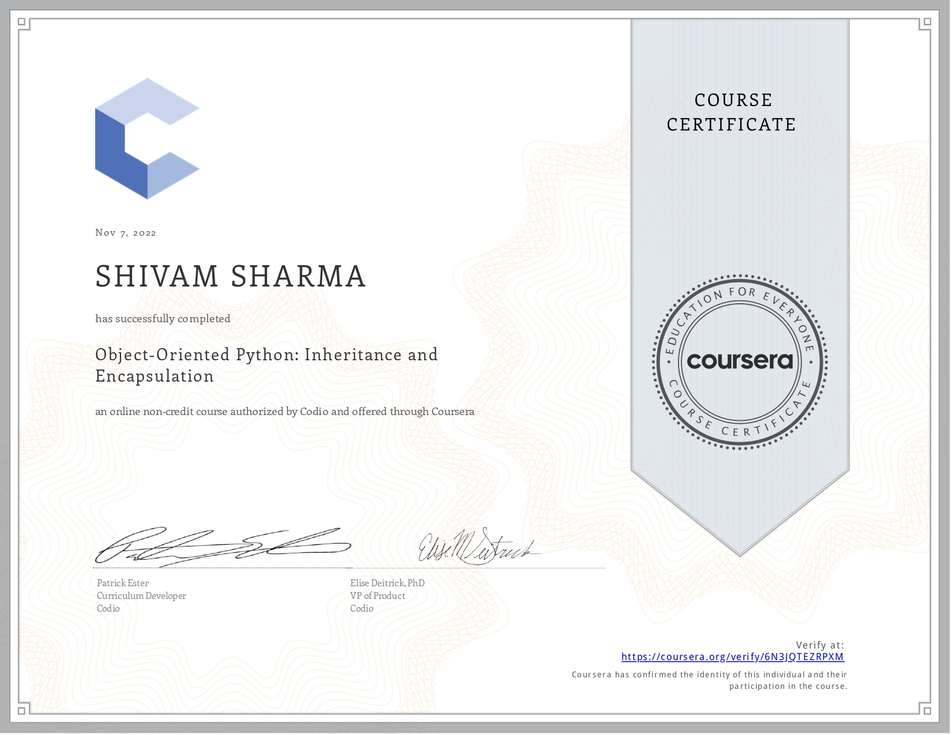
Object-Oriented Python: Inheritance and Encapsulation https://www.coursera.org/account/accomplishments/verify/6N3JQTEZRPXM

Slide 10
Research on HTML5 in Web Development 2012 BY: Ch Rajesh, K S V Krishna Srikanth
HTML5 introduces new elements and features that allow developers to improve interoperability, handling elements in a precise way saving time and costs. HTML5 is an awesome technology and has the possibility to make the web even more predominant and extensive as it is today from desktop computers to mobile devices and in the future maybe even domestics appliances. The potential of HTML5 will soften the line between desktop and online applications. The problem HTML5 may suffer in the coming days is that an opportunity will be available for the malware writers which may make today's common hacks.

Slide 11
The Role of Responsive Design in Web Development 2017 by:International Journal of Information Technology and Web Engineering
This paper discusses about role of responsive website.
Responsive design allows software developers to build a Web page that can dynamically adapt to the size of the devices.
Web 2.0 includes a large and diverse panoply of services, such as social networks, blogs and wikis, that promote collaboration and the fast exchange of information among users. Andriole (2010) states that Web 2.0 has helped companies to become more competitive and position themselves in the marketplace. The main advantage associated with Web 2.0 is its potential in establishing collaboration, and the main disadvantage is the loss of control of the shared information. Web 4.0 proposes a new model of interaction that is more complete, dynamic, and personalized, in which there is a symbiotic interaction between human and machines

Slide 12
New technologies for web design. 2010 Grega Jakus, Saso Tomazic
The paper gives an overview of the new features of web technologies. The general idea of the new version of HTML (Hyper Text Markup Language), i.e. HTML5, and other tools presented in this paper is the formal specification and the establishment of uniform solutions for technologies and functionalities which have already been in use through various hacks and plug-ins proposed by web developers.

Slide 13
Javascript in html (Nicholas C. zakas) 2019
This chapter discusses the script element, tag placement and deprecated syntax, compares inline and external scripts, examines how document modes affect JavaScript and prepares the reader for JavaScript-disabled experiences. The introduction of JavaScript into web pages immediately ran into the Web's predominant language, HTML. JavaScript is inserted into HTML pages using the script element

Slide 14
Journal of Engineering Design 2007
• According to the research paper, Virtual reality (VR) is a tool that today is used by experts in the performance of mechanical engineering and industrial design. VR has especially found its use in the automotive industry. • This research paper focuses on what is needed for the use of already existing VR files as web applications with the aim of spreading the use of VR applications to a wider group of people than engineers and designers.

Slide 15

CONCLUSION….
The purpose and objective of the Web development and machine learning internship is achieved. We were able to learn a lot about web developmemt and machine learning and by the daily task assignment and with these minor project we are helped too much in remembering and learning. By providing extremely rich graphical interface, web page designing is easy and in an asthetic form.Flexibility in designing makes user explore their imaginations and thus users can accomplish their wish of web page designing. I learned how to deploy machine learning project on website using streamlit python library

